Slide 1
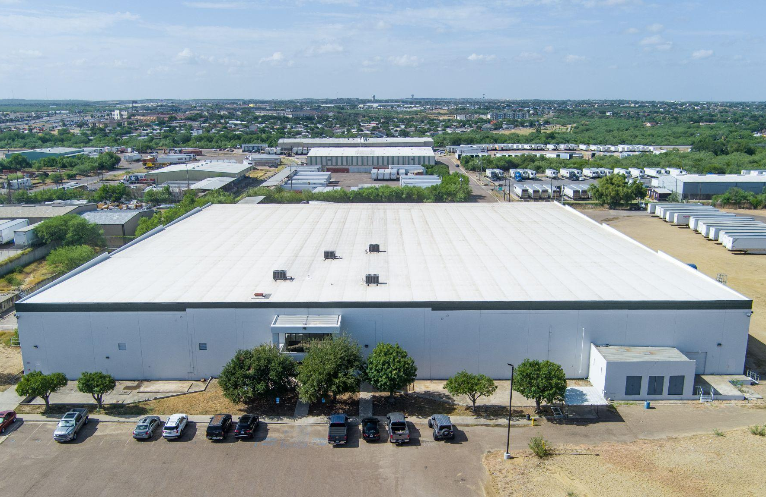
Q1 2026 Update
1820 Aguila Azteca LLC
PROJECT DETAILS
Address
1820 Aguila Azteca Dr
Laredo, TX 78043
Purchase date
4/24/2025
Purchase price
$12,960,000
Size
108,248 sq ft
Number of units
2
Year built
2000
Property Updates
The Laredo industrial market is still under pressure. Vacancy across the market is now approaching 20%, driven by the same tariff-related uncertainty that has kept tenant decision-making largely on hold for the better part of a year. Business owners are hesitant to sign leases or commit to expansions until there is more clarity on trade policy, and we expect this softness to persist in the near term. On the bright side, multiple brokers in the area report that dozens of companies are planning expansions into the area, representing millions of square feet of new leasing, which they will trigger once certainty on trade relations is reached and maintained.
AGC, our in-place tenant occupying approximately 67% of the building, is running a profitable business and paying rent on time. The expansion conversation we referenced last month, where their warehouse manager expressed interest in taking the remaining space, has not yet advanced. Any expansion on their part would be contract-dependent, and we are maintaining an open and constructive relationship with them as that situation develops.
Our broker is actively working the market, and there are several prospects at various early stages of engagement. None are close to a lease at this time, and we want to be careful not to get ahead of conversations that are still very preliminary. We will report back as any of these develop into something more concrete.
Our strategy remains the same: hold, push on leasing, and allow the market time to recover. We are closely monitoring

Slide 2
Q1 2026 Update
1820 Aguila Azteca LLC
U.S.-Mexico trade negotiations and believe that clarity on trade policy will be the unlock for this market.
Financial Updates
As of writing this update, the total cash and reserve balance is $453,199. Financials for this investment have been uploaded to the investor portal for you to view.
What We’re Reading
March 2026 Industrial Report: The Massive Restructuring of Retail Fulfillment
- Commercial Cafe, March 2026
Peak Industrial Vacancy Likely in Rearview Mirror as Demand Holds and Supply Slows
- Cushman & Wakefield, April 2026
Elevated Costs And Complicated Cap Stacks Can't Stop DFW Deals From Getting Done
- Bisnow, April 2026
2026 Texas Real Estate Forecast
- Texas Real Estate Research Center, TAMU, January 2026

Slide 3
Q1 2026 Update
1820 Aguila Azteca LLC
Q1 Market Update: Laredo
Market overview
Conditions in the Laredo industrial market deteriorated further in Q1, with vacancy climbing sharply to 19.6%, up from 12.1% at year-end 2025. The increase was driven by 3.7 million square feet of new deliveries that arrived with only 8.8% of space pre-committed, adding a significant volume of vacant product to a market already working through excess supply. Net absorption was effectively flat at just 16,000 square feet for the quarter, a sharp drop from the 248,000 square feet posted in Q4 2025. The market is not absorbing new supply.
The bifurcation between Class A and Class B product that defined Q4 has continued into 2026, but the numbers are starker. Class A space posted 84,000 square feet of positive absorption in Q1, while Class B recorded negative 146,000 square feet. Class A vacancy now sits at 44.7% across the market, a direct reflection of how much new, unleased product has delivered in recent quarters. Class B vacancy at 5.8% tells a different story: older, functional, infill product is proving more resilient, while the new speculative wave sits empty around it.
The pipeline is a significant concern
An additional 6.7 million square feet of speculative product is underway for delivery over the next 18 months, currently 12.7% pre-leased to a single tenant in a build-to-suit arrangement. That means roughly 5.8 million square feet of additional speculative supply is coming to a market that absorbed just 16,000 square feet in Q1. The North submarket alone has 4.4 million square feet under construction, where Class A vacancy is already at 52.5%. Without a meaningful acceleration in leasing velocity, vacancy will move higher before it moves lower.
Trade policy uncertainty continues to drive tenant behavior
The fundamental demand driver for Laredo industrial has not changed. The Port of Laredo handled nearly $354 billion in trade in 2025, and 15,000 trucks cross the World Trade Bridge daily. Cross-border infrastructure investment continues, with the proposed expansion of the World Trade Bridge from eight to 18 lanes and a new high-capacity international rail bridge both moving forward. The long-term case for Laredo as a logistics gateway remains intact.
What has changed is tenant willingness to act on that thesis. Occupiers continue to delay long-term space commitments in anticipation of July 2026 USMCA renegotiations and further clarity on tariff policy. Until that uncertainty resolves, leasing velocity is unlikely to accelerate meaningfully, and the gap between supply and demand will remain wide. Laredo also fell to second place among U.S. ports by trade volume in early 2026, trailing JFK International Airport with $58 billion in YTD trade volume through February, a continuation of the relative ranking decline noted in Q4.
Investor takeaway
Laredo is in the most challenging phase of its cycle. Vacancy at 19.6% is a market-level number that reflects the consequences of speculative development running well ahead of demand, compounded by a tenant base that is unwilling to make long-term commitments until trade policy becomes clearer. The assets performing in this environment are older, functional Class B buildings in established locations, not the new Class A product that dominates the current pipeline. A meaningful recovery requires two things that are not yet in place: trade policy clarity and an extended pause in new construction. Until both arrive, the market has more room to fall than recover.

